Slide 1



Perspectives on Cloud Programmability
Don Syme, @dsyme, MSR Cambridge, 23/07/2015

Slide 2
observation #0 Growing Azure is critical to our future

Slide 3
observation #1 Being great leaders in cloud programming is a part of this

Slide 4
problem #1 It takes a lot to be a great cloud language functional, web, async, actors, big data, analytics, time series, data frames, HDFS, GPGPU, data integration, …

Slide 5
problem #2 Making great cloud programming tech is hard, expensive and risky Microsoft history is littered with expensive failures (WCF!) and ignored successes (Rx!)

Slide 6
problem #3 Openness wins in cloud programming tech better, more viral, darwinian, sustainable, multi-contributor

Slide 7
approach: Assess and embrace F# open, community-developed cloud tech for Azure

Slide 8

2012
Language |  | F# |  | C#
Web | ½ |  |  | ASP.NET
Big Data + Big Compute
Actors
Data Analytics
GPU
Simple Data
Cloud Data

Slide 9
2012
Language |  | F# |  | C#
Web | ½ |  |  | ASP.NET
Big Data + Big Compute | ✗ |  | ✗
Actors | ½ |  | ✗
Data Analytics | ✗ |  | ½
GPU | ✗ |  | ✗
Simple Data | ½ |  | ½
Cloud Data | ✗ |  | ✗

Slide 10
2015, by embracing open community
Language | F#
Web | suave.io, WebSharper, …
Big Data + Big Compute | Mbrace, …
Actors | AkkaDotNet, …
Data Analytics | fslab.org, …
GPU | Alea.GPU, …
Simple Data | FSharp.Data, …
Cloud Data | Azure Type Providers, …

Slide 11
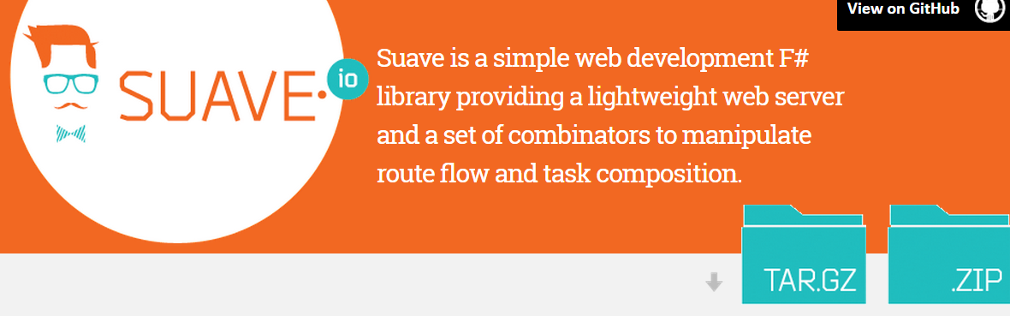
100% open source, community driven

Slide 12
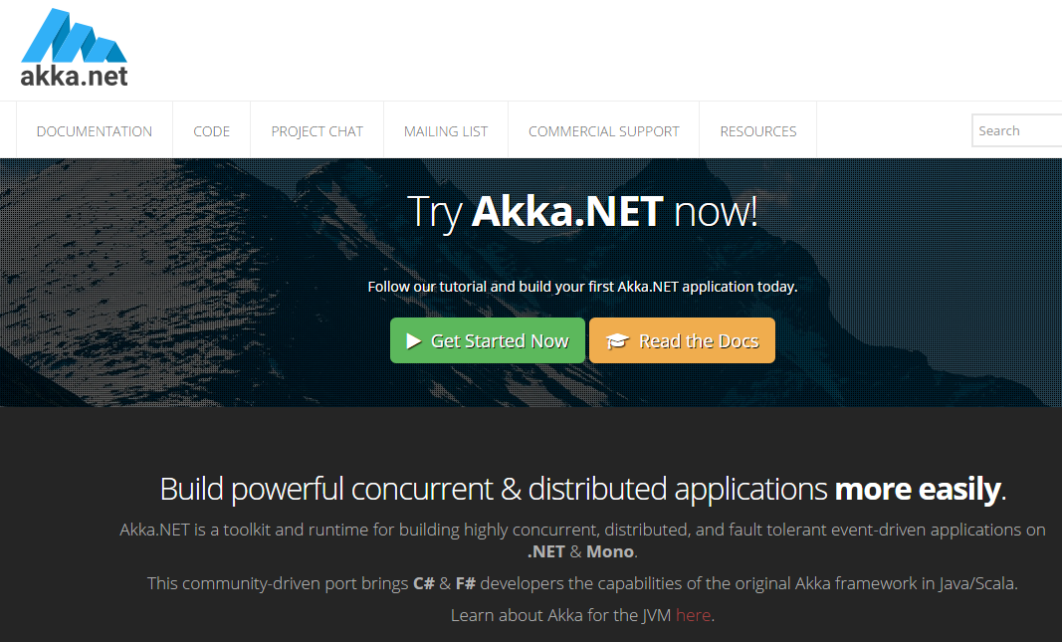
100% open source, community driven

Slide 13
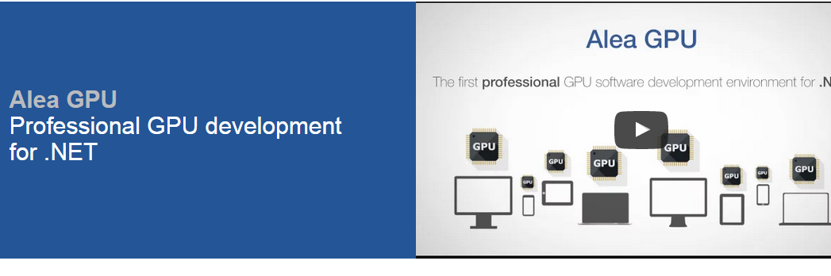

Slide 14
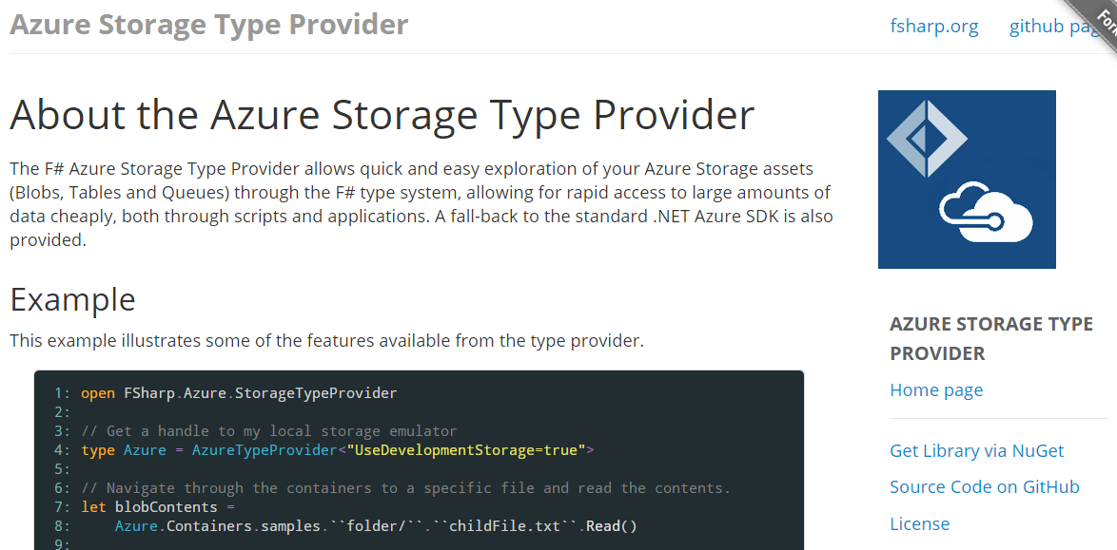

Slide 15

100% open source, community driven

Slide 16
async { … }
Shared memory
Maps to tasks

Slide 17
cloud { … }
No shared memory
Maps to cloud tasks

Slide 18
Demo
MBrace

Slide 19
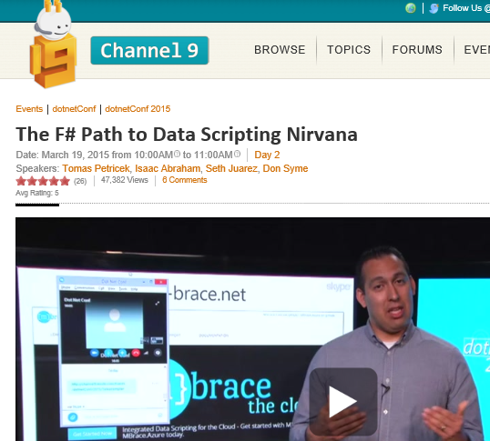
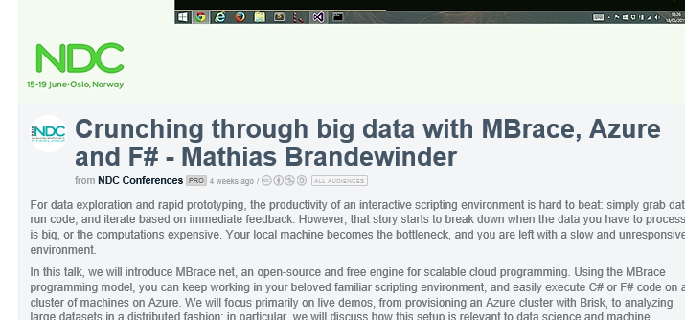
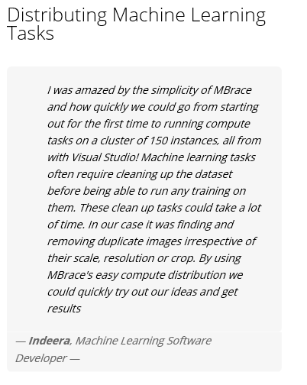
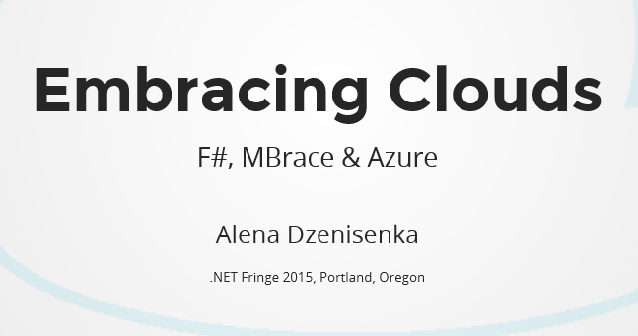

Slide 20
Summary & Future
Openness wins in cloud programming tech
Super happy with the results (for low cost)
Azure Compute + GPU
F# feature set is the right basis
Azure Compute + MBrace
A base for future R&D

Slide 21
Questions?

